Slide 1
Chapter 8:
Subnetting IP Networks
CCNA Routing and Switching
Introduction to Networks v6.0
Notes:
Cisco Networking Academy Program
Introduction to Networks v6.0
Chapter 8: Subnetting IP Networks

Slide 2
Chapter 8 - Sections & Objectives
8.1 Subnetting an IPv4 Network
  Implement an IPv4 addressing scheme to enable end-to-end connectivity in a small to medium-sized business network.
  Explain how subnetting segments a network to enable better communication.
  Explain how to calculate IPv4 subnets for a /24 prefix.
  Explain how to calculate IPv4 subnets for a /16 and /8 prefix.
  Given a set of requirements for subnetting, implement an IPv4 addressing scheme.
  Explain how to create a flexible addressing scheme using variable length subnet masking (VLSM).
8.2 Addressing Schemes
  Given a set of requirements, implement a VLSM addressing scheme to provide connectivity to end users in a small to medium-sized network.
  Implement a VLSM addressing scheme.
Notes:
2
Cisco Networking Academy Program
Introduction to Networks v6.0
Chapter 8: Subnetting IP Networks

Slide 3
Chapter 8 - Sections & Objectives (Cont.)
8.3 Address Schemes
  Explain design considerations for implementing IPv6 in a business network.
  Explain how to implement IPv6 address assignments in a business network.
Notes:
3
Cisco Networking Academy Program
Introduction to Networks v6.0
Chapter 8: Subnetting IP Networks

Slide 4
8.1 Subnetting an IPv4 Network
Notes:
8 – Subnetting IP Networks
8.1 – Subnetting an IPv4 Network

Slide 5
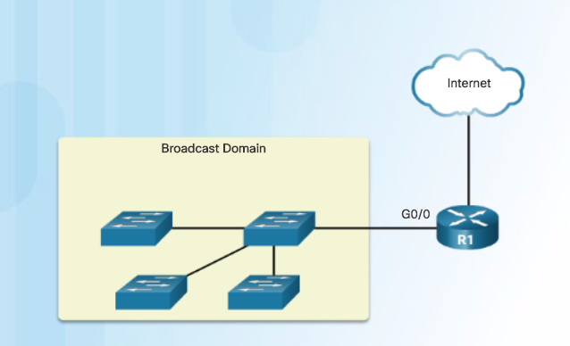
Network Segmentation
Broadcast Domains
Devices use broadcasts in an Ethernet LAN to locate:
  Other devices - Address Resolution Protocol (ARP) which sends Layer 2 broadcasts to a known IPv4 address on the local network to discover the associated MAC address.
  Services – Dynamic Host Configuration Protocol (DHCP) which sends broadcasts on the local network to locate a DHCP server.
Switches propagate broadcasts out all interfaces except the interface on which it was received.
Notes:
8.1 – Subnetting an IPv4 Network
8.1.1 – Network Segmentation
8.1.1.1 – Broadcast Domains

Slide 6
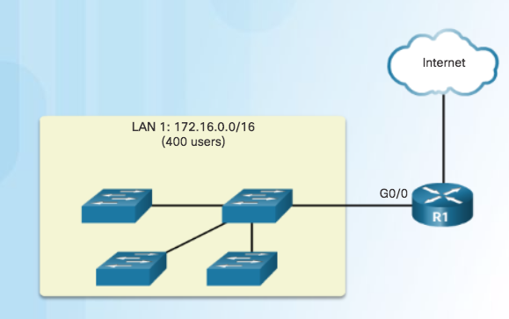
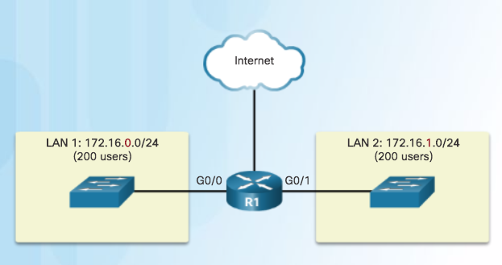
Network Segmentation
Problems with Large Broadcast Domains
Hosts can generate excessive broadcasts and negatively affect the network.
  Slow network operations due to the significant amount of traffic it can cause.
  Slow device operations because a device must accept and process each broadcast packet.
Solution: Reduce the size of the network to create smaller broadcast domains. These smaller network spaces are called subnets.
One Broadcast Domain
Broadcast in LAN 1 contained in 1 subnet
Broadcast in LAN 2 contained in 1 subnet
Notes:
8.1 – Subnetting an IPv4 Network
8.1.1 – Network Segmentation
8.1.1.2 – Problems with Large Broadcast Domains

Slide 7
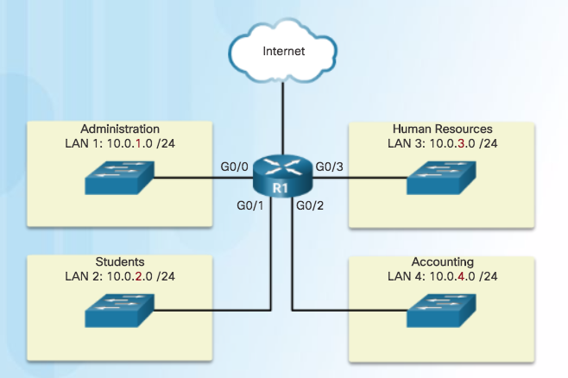
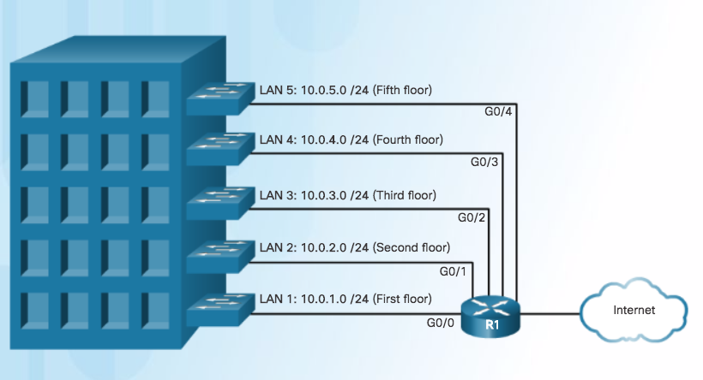
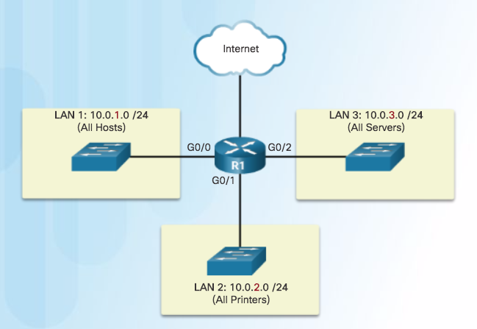
Network Segmentation
Reasons for Subnetting
Reduces overall network traffic and improves network performance.
Enables an administrator to implement security policies such as which subnets are allowed or not allowed to communicate together.
Communicating between
Networks
Subnetting by Location
Subnetting by Device Type
Notes:
8.1 – Subnetting an IPv4 Network
8.1.1 – Network Segmentation
8.1.1.2 – Reasons for Subnetting

Slide 8
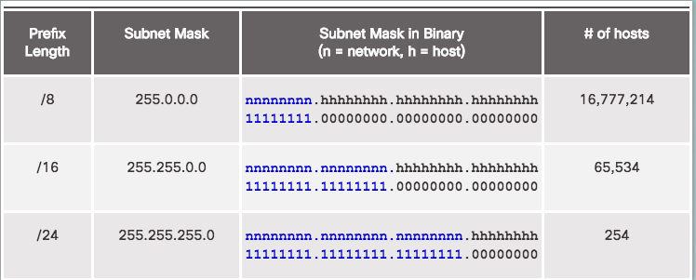
Subnetting an IPv4 Network
Octet Boundaries
Networks are most easily subnetted at the
octet boundary of /8, /16, and /24
Prefix length and the subnet mask are different ways of identifying the network portion of an address.
Subnets are created by borrowing host bits for network bits.
More host bits borrowed, the more subnets that can be defined.
Notes:
8.1 – Subnetting an IPv4 Network
8.1.2 – Subnetting an IPv4 Network
8.1.2.1 – Octet Boundaries

Slide 9
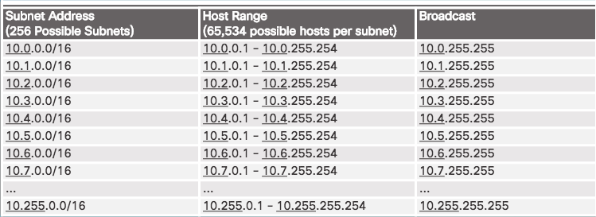
Subnetting an IPv4 Network
Subnetting on the Octet Boundary
Subnetting Network 10.x.0.0/16
Define up to 256 subnets with each subnet capable of connecting 65,534 hosts.
First two octets identify the network portion while the last two octets are for host IP addresses.
Notes:
8.1 – Subnetting an IPv4 Network
8.1.2 – Subnetting an IPv4 Network
8.1.2.2 – Subnetting on the Octet Boundary

Slide 10
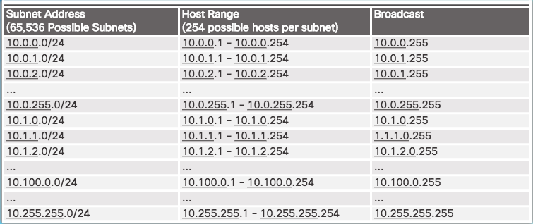
Subnetting an IPv4 Network
Subnetting on the Octet Boundary (Cont.)
Subnetting Network 10.x.x.0/24
Define 65,536 subnets each capable of connecting 254 hosts.
/24 boundary is very popular in subnetting because of number of hosts.
Notes:
8.1 – Subnetting an IPv4 Network
8.1.2 – Subnetting an IPv4 Network
8.1.2.2 – Subnetting on the Octet Boundary

Slide 11
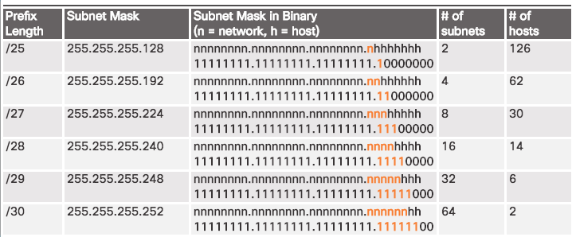
Subnetting an IPv4 Network
Classless Subnetting
Subnetting a /24 Network
Subnets can borrow bits from any host bit position to create other masks.
Notes:
8.1 – Subnetting an IPv4 Network
8.1.2 – Subnetting an IPv4 Network
8.1.2.3 – Classless Subnetting

Slide 12
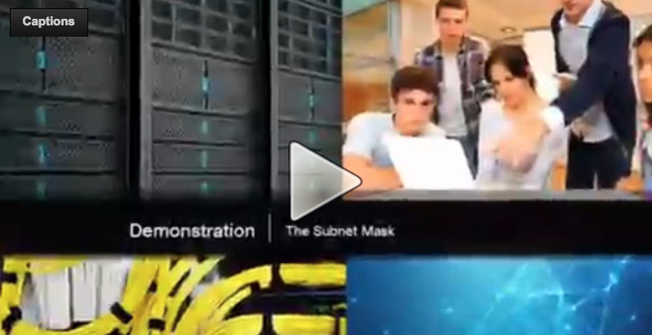
Subnetting an IPv4 Network
Video Demonstration – The Subnet Mask
Subnetting in Binary
ANDING
  Convert IP address and Subnet Mask to Binary (line up vertically like an addition problem)
  Logically AND (1 and 1 = 1, all other combinations = 0)
  Result is network address for original IP address
Classful Subnetting
  Class A /8 255.0.0.0
  Class B /16 255.255.0.0
  Class C /24 255.255.255.0
Notes:
8.1 – Subnetting an IPv4 Network
8.1.2 – Subnetting an IPv4 Network
8.1.2.4 – Video – The Subnet Mask

Slide 13
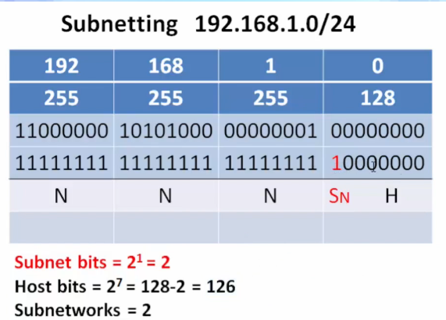
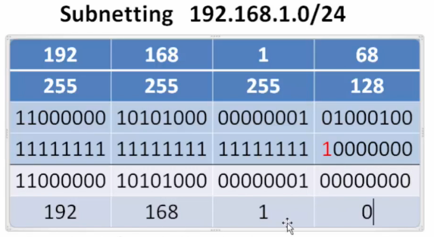

Subnetting an IPv4 Network
Video Demonstration – The Subnet Mask (Cont.)
Notes:
8.1 – Subnetting an IPv4 Network
8.1.2 – Subnetting an IPv4 Network
8.1.2.4 – Video – The Subnet Mask

Slide 14
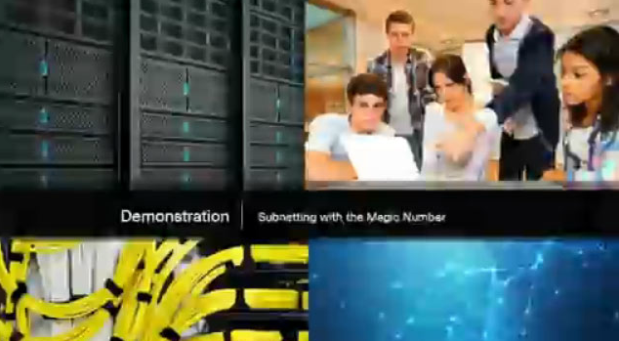
Subnetting an IPv4 Network
Video Demonstration – Subnetting with the Magic Number
Magic number technique used to calculate subnets
Magic number is simply the place value of the last one in the subnet mask
/25 11111111.11111111.11111111.10000000 magic number = 128
/26 11111111.11111111.11111111.11000000 magic number = 64
/27 11111111.11111111.11111111.11100000 magic number = 32
Notes:
8.1 – Subnetting an IPv4 Network
8.1.2 – Subnetting an IPv4 Network
8.1.2.5 – Video – Subnetting with the Magic Number

Slide 15
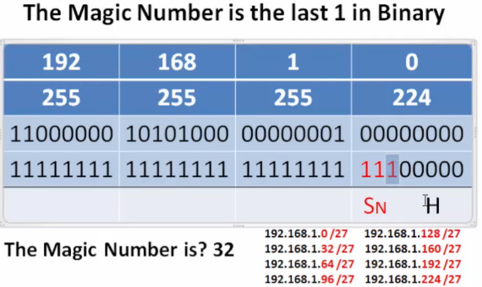
Subnetting an IPv4 Network
Video Demonstration – Subnetting with the Magic Number (Cont.)
Notes:
8.1 – Subnetting an IPv4 Network
8.1.2 – Subnetting an IPv4 Network
8.1.2.5 – Video – Subnetting with the Magic Number

Slide 16
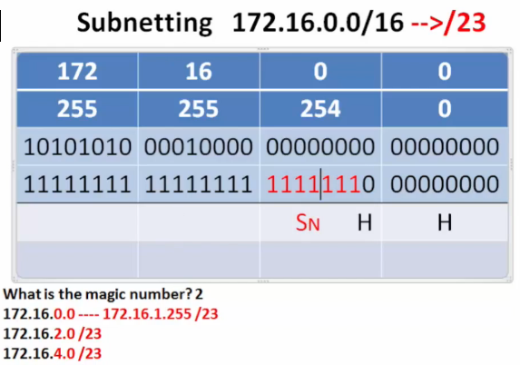
Subnetting an IPv4 Network
Video Demonstration – Subnetting with the Magic Number (Cont.)
Notes:
8.1 – Subnetting an IPv4 Network
8.1.2 – Subnetting an IPv4 Network
8.1.2.5 – Video – Subnetting with the Magic Number

Slide 17
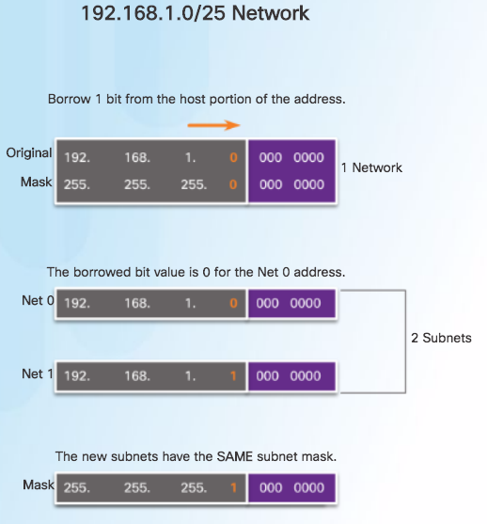
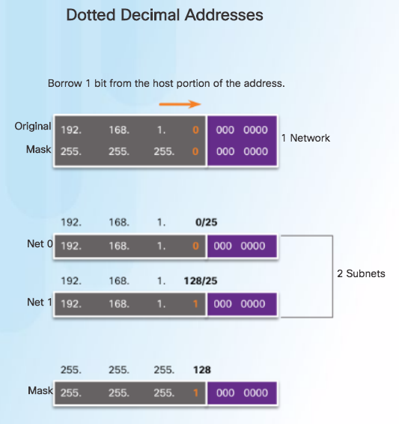
Subnetting an IPv4 Network
Classless Subnetting Example
Notes:
8.1 – Subnetting an IPv4 Network
8.1.2 – Subnetting an IPv4 Network
8.1.2.6 – Classless Subnetting Example

Slide 18
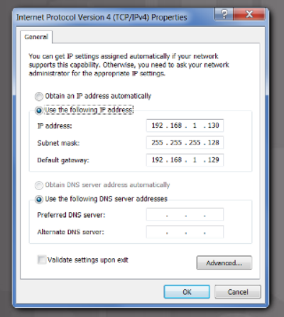
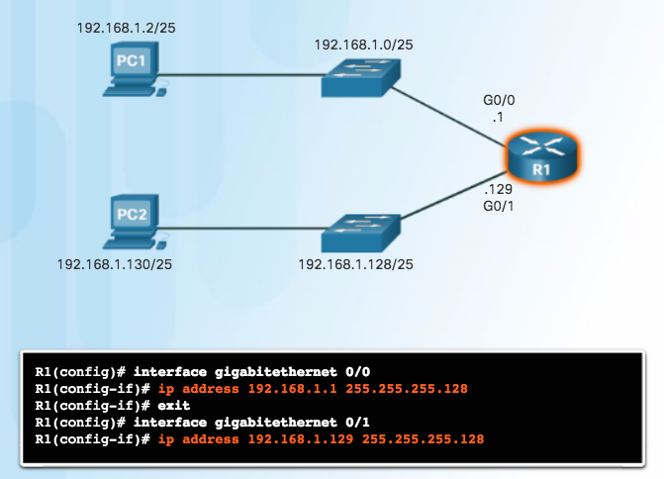
Subnetting an IPv4 Network
Creating 2 Subnets
/25 Subnetting Topology
Notes:
8.1 – Subnetting an IPv4 Network
8.1.2 – Subnetting an IPv4 Network
8.1.2.7 – Creating 2 Subnets

Slide 19
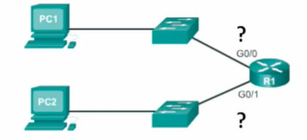
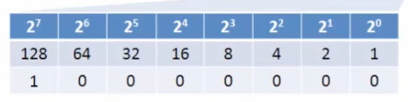
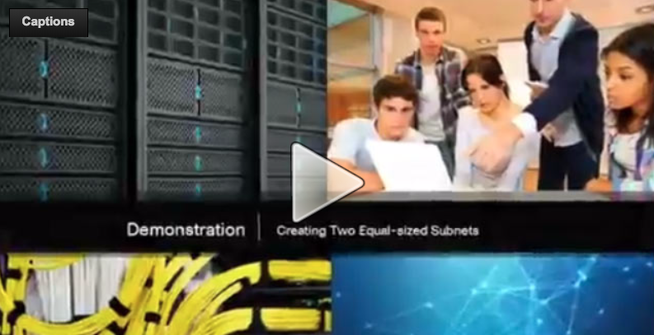
Subnetting an IPv4 Network
Video Demonstration – Creating Two Equal-sized Subnets (/25)
Create 2 Equal-sized Subnets from 192.168.1.0 /24
Subnet Mask - 11111111.11111111.11111111.10000000
Magic Number = 128
192.168.1.0 /25 (start at 0)
192.168.1.128 /25 (Add 128)
Notes:
8.1 – Subnetting an IPv4 Network
8.1.2 – Subnetting an IPv4 Network
8.1.2.8 – Video Demonstration – Creating Two Equal-sized Subnets (/25)

Slide 20
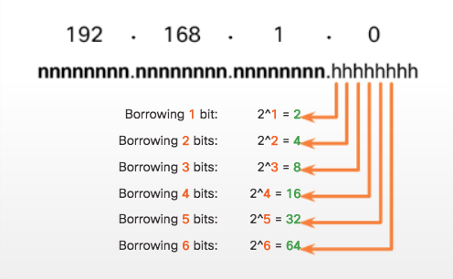
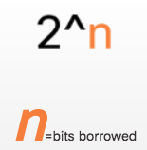
Subnetting an IPv4 Network
Subnetting Formulas
Calculate Number of Subnets Formula
Subnetting a /24 Network
Notes:
8.1 – Subnetting an IPv4 Network
8.1.2 – Subnetting an IPv4 Network
8.1.2.9 – Subnetting Formulas

Slide 21
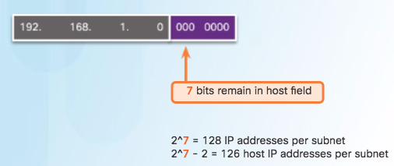
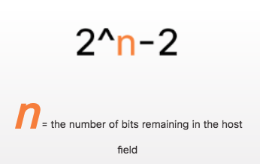
Subnetting an IPv4 Network
Subnetting Formulas (Cont.)
Calculate Number of Hosts Formula
Calculating the Number of Hosts
Notes:
8.1 – Subnetting an IPv4 Network
8.1.2 – Subnetting an IPv4 Network
8.1.2.9 – Subnetting Formulas

Slide 22
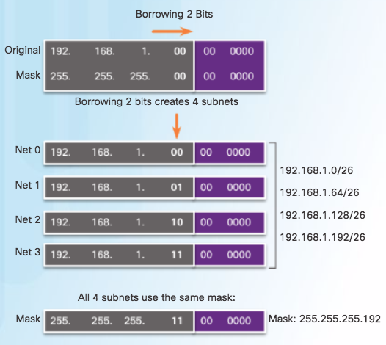
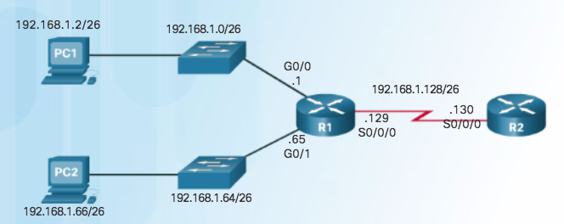
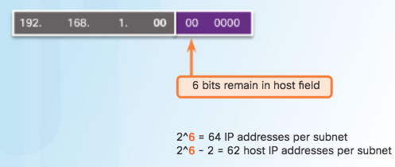
Subnetting an IPv4 Network
Creating 4 Subnets
/26 Subnetting Topology
Notes:
8.1 – Subnetting an IPv4 Network
8.1.2 – Subnetting an IPv4 Network
8.1.2.10 – Creating 4 Subnets

Slide 23
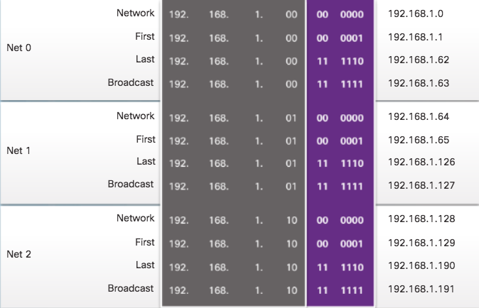
Subnetting an IPv4 Network
Creating 4 Subnets (Cont.)
/26 Subnetting Topology
Notes:
8.1 – Subnetting an IPv4 Network
8.1.2 – Subnetting an IPv4 Network
8.1.2.10 – Creating 4 Subnets

Slide 24
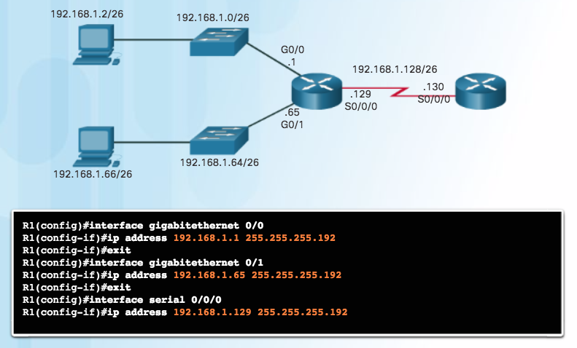
Subnetting an IPv4 Network
Creating 4 Subnets (Cont.)
/26 Subnetting Topology
Notes:
8.1 – Subnetting an IPv4 Network
8.1.2 – Subnetting an IPv4 Network
8.1.2.10 – Creating 4 Subnets

Slide 25
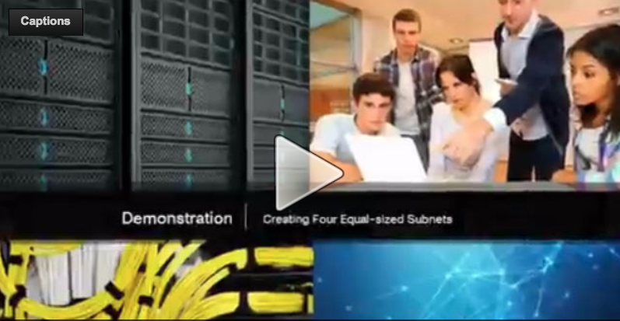
Subnetting an IPv4 Network
Video Demonstration – Creating Four Equal-sized Subnets (/26)
Create 4 Equal-sized Subnets from 192.168.1.0 /24
Subnet Mask in Binary – 11111111.11111111.11111111.11000000
2^2 = 4 Subnets
Magic Number = 64
192.168.1.0 /26
192.168.1.64 /26
192.168.1.128 /26
192.168.1.192 /26
Notes:
8.1 – Subnetting an IPv4 Network
8.1.2 – Subnetting an IPv4 Network
8.1.2.11 – Video Demonstration – Creating Four Equal-sized Subnets (/26)

Slide 26
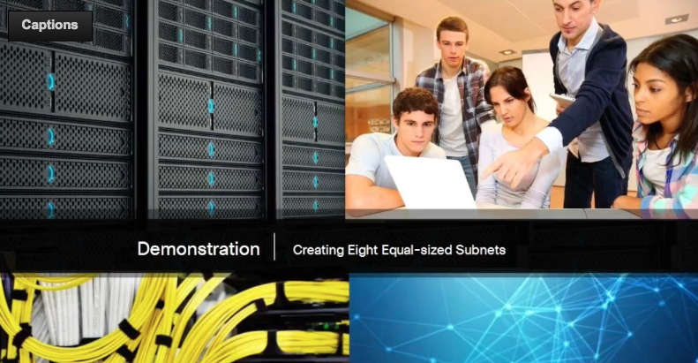
Subnetting an IPv4 Network
Video Demonstration – Creating Eight Equal-sized Subnets (/27)
Create 8 Equal-sized Subnets from 192.168.1.0 /24
Borrow 3 bits – 11111111.11111111.11111111.11100000
Magic Number = 32
192.168.1.0 /27 (Start at 0)
192.168.1.32 /27 (Add 32 to previous network)
192.168.1.64 /27 (Add 32)
192.168.1.96 /27 (Add 32)
192.168.1.128 /27 (Add 32)
192.168.1.160 /27 (Add 32)
192.168.1.192 /27 (Add 32)
192.168.1.224 /27 (Add 32)
Notes:
8.1 – Subnetting an IPv4 Network
8.1.2 – Subnetting an IPv4 Network
8.1.2.12 – Video Demonstration – Creating Eight Equal-sized Subnets (/27)

Slide 27
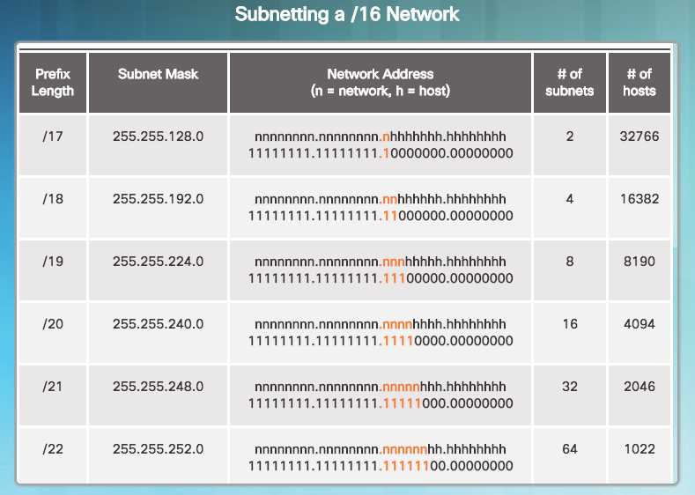
Subnetting a /16 and /8 Prefix
Creating Subnets with a /16 prefix
Notes:
8.1 – Subnetting an IPv4 Network
8.1.3 – Subnetting a /16 and /8 Prefix
8.1.3.1 – Creating Subnets with a /16 prefix

Slide 28
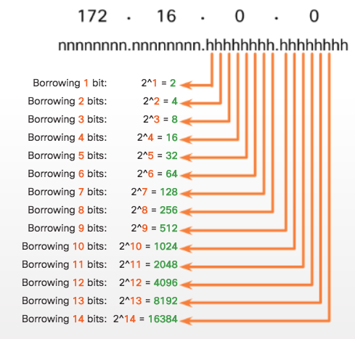
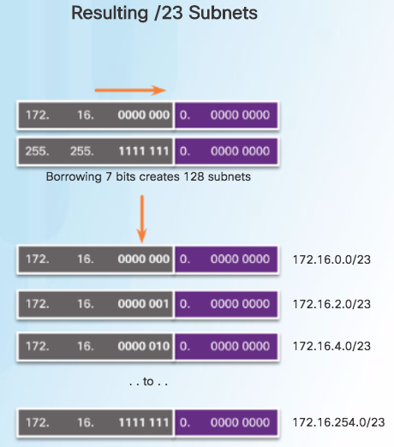
Subnetting a /16 and /8 Prefix
Creating 100 Subnets with a /16 prefix
Notes:
8.1 – Subnetting an IPv4 Network
8.1.3 – Subnetting a /16 and /8 Prefix
8.1.3.2 – Creating 100 Subnets with a /16 prefix

Slide 29
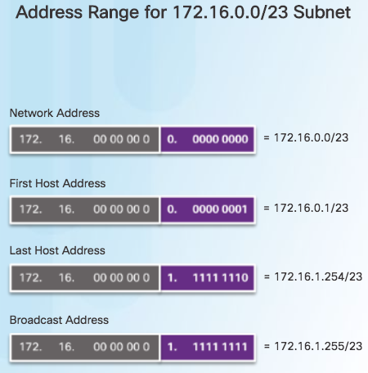
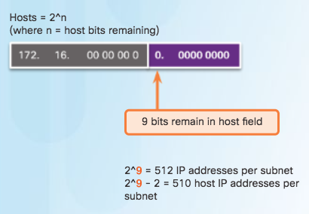
Subnetting a /16 and /8 Prefix
Calculating the Hosts
Notes:
8.1 – Subnetting an IPv4 Network
8.1.3 – Subnetting a /16 and /8 Prefix
8.1.3.3 – Calculating the Hosts

Slide 30
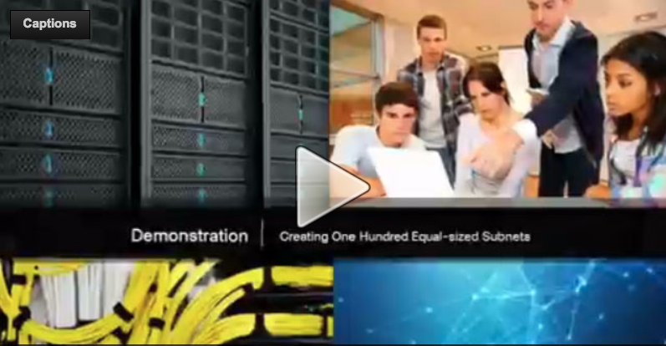
Subnetting a /16 and /8 Prefix
Video Demonstration – Creating One Hundred Equal-sized Subnets
An enterprise network requires 100 equal-sized subnets starting from 172.16.0.0/16
  New Subnet Mask
    11111111.11111111.11111110.00000000
  2^7 = 128 Subnets
  2^9 = 512 hosts per subnet
  Magic Number = 2
  172.16.0.0 /23
  172.16.2.0 /23
  172.16.4.0 /23
  172.16.6.0 /23
  …
  172.16.254.0 /23
Notes:
8.1 – Subnetting an IPv4 Network
8.1.3 – Subnetting a /16 and /8 Prefix
8.1.3.4 – Video Demonstration – Creating One Hundred Equal-sized Subnets

Slide 31
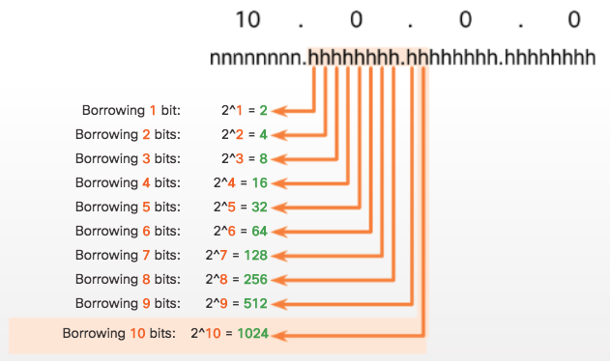
Subnetting a /16 and /8 Prefix
Creating 1000 Subnets with a /8 Network
Notes:
8.1 – Subnetting an IPv4 Network
8.1.3 – Subnetting a /16 and /8 Prefix
8.1.3.5 – Creating 1000 Subnets with a /8 Network

Slide 32
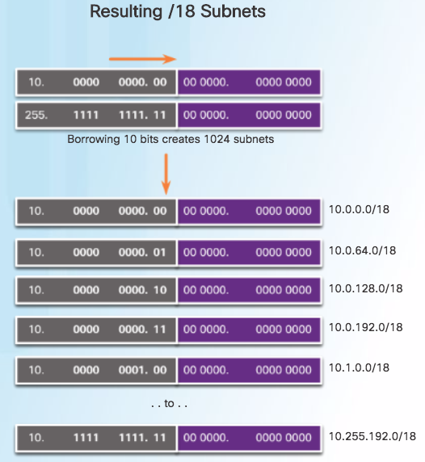
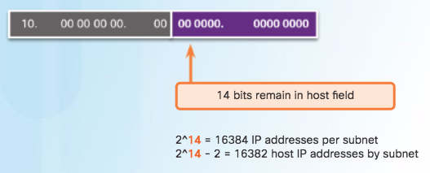
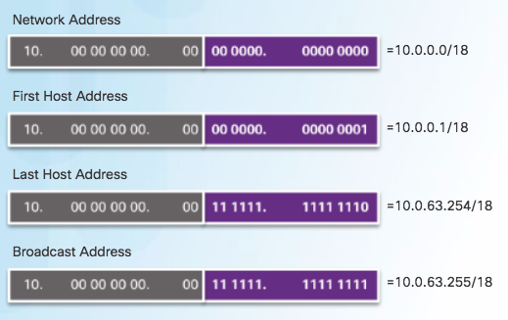
Subnetting a /16 and /8 Prefix
Creating 1000 Subnets with a /8 Network (Cont.)
Notes:
8.1 – Subnetting an IPv4 Network
8.1.3 – Subnetting a /16 and /8 Prefix
8.1.3.5 – Creating 1000 Subnets with a /8 Network

Slide 33
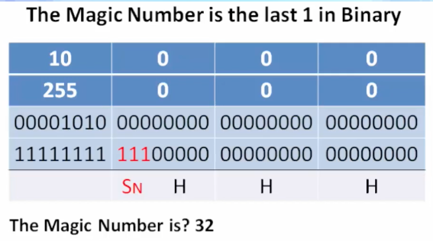
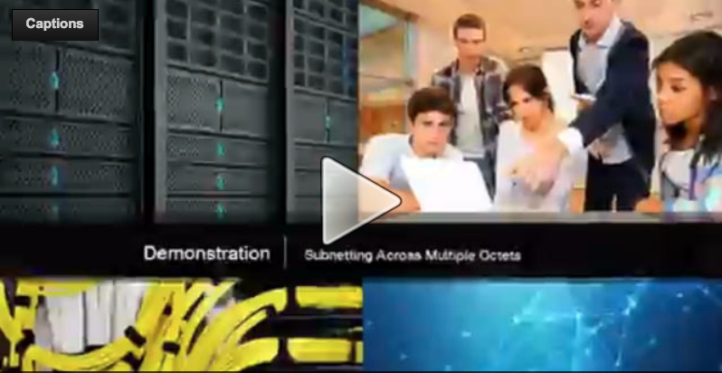

Subnetting a /16 and /8 Prefix
Video Demonstration – Subnetting Across Multiple Octets
New Challenge Problem: Create over 300 Equal-sized Subnets of 20,000 Hosts each starting from 10.0.0.0/8
Notes:
8.1 – Subnetting an IPv4 Network
8.1.3 – Subnetting a /16 and /8 Prefix
8.1.3.6 – Video Demonstration – Subnetting Across Multiple Octets

Slide 34
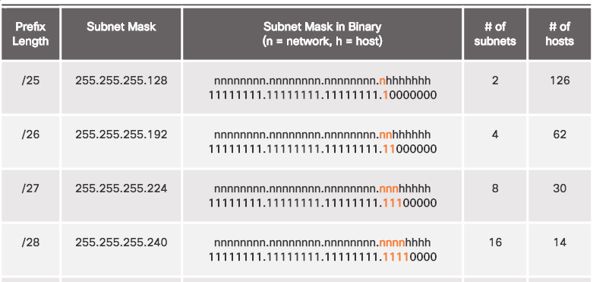
Subnetting to Meet Requirements
Subnetting Based on Host Requirements
Notes:
8.1 – Subnetting an IPv4 Network
8.1.4 – Subnetting to Meet Requirements
8.1.4.1 – Subnetting Based on Host Requirements

Slide 35
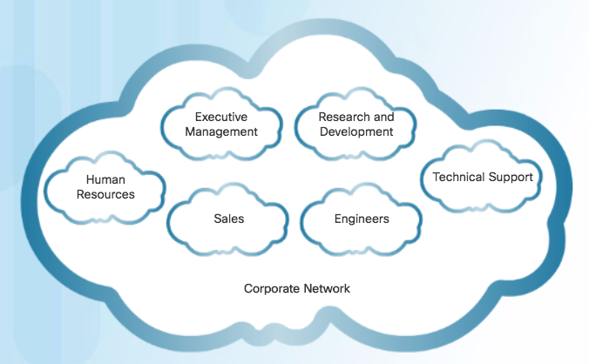
Subnetting to Meet Requirements
Subnetting Based On Network Requirements
Host devices used by employees in the Engineering department in one network and Management in a separate network.
Notes:
8.1 – Subnetting an IPv4 Network
8.1.4 – Subnetting to Meet Requirements
8.1.4.2 – Subnetting Based On Network Requirements

Slide 36
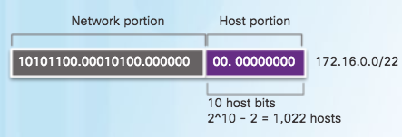
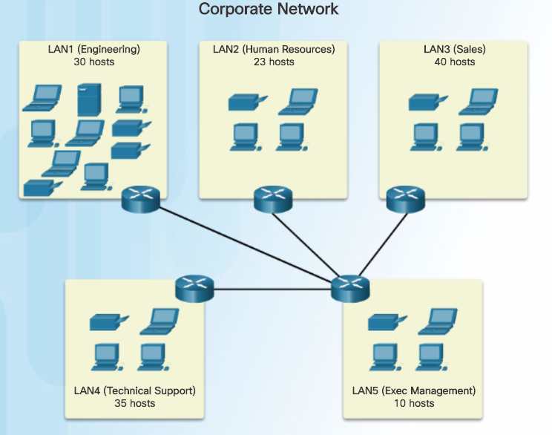

Subnetting to Meet Requirements
Network Requirement Example
Notes:
8.1 – Subnetting an IPv4 Network
8.1.4 – Subnetting to Meet Requirements
8.1.4.3 – Network Requirement Example

Slide 37

Subnetting to Meet Requirements
Network Requirement Example (Cont.)
Notes:
8.1 – Subnetting an IPv4 Network
8.1.4 – Subnetting to Meet Requirements
8.1.4.3 – Network Requirement Example

Slide 38



Benefits of Variable Length Subnet Masking
Traditional Subnetting Wastes Addresses
Notes:
8.1 – Subnetting an IPv4 Network
8.1.5 – Benefits of Variable Length Subnet Masking
8.1.5.1– Traditional Subnetting Wastes Addresses

Slide 39


Benefits of Variable Length Subnet Masking
Variable Length Subnet Masks (VLSM)
Traditional
Subnets of Varying Sizes
Notes:
8.1 – Subnetting an IPv4 Network
8.1.5 – Benefits of Variable Length Subnet Masking
8.1.5.2 – Variable Length Subnet Masks (VLSM)

Slide 40


Benefits of Variable Length Subnet Masking
Basic VLSM
Basic Subnetting
Notes:
8.1 – Subnetting an IPv4 Network
8.1.5 – Benefits of Variable Length Subnet Masking
8.1.5.3 – Basic VLSM

Slide 41


Benefits of Variable Length Subnet Masking
Video Demonstration – VLSM Basics
Basic VLSM
  Subnets do not have to be equal sizes, as long as their address ranges do not overlap.
  When creating subnets it is easier to work from larger to smaller.
Notes:
8.1 – Subnetting an IPv4 Network
8.1.5 – Benefits of Variable Length Subnet Masking
8.1.5.4 – Video Demonstration – VLSM Basics

Slide 42

Benefits of Variable Length Subnet Masking
VLSM in Practice
Notes:
8.1 – Subnetting an IPv4 Network
8.1.5 – Benefits of Variable Length Subnet Masking
8.1.5.5 – VLSM in Practice

Slide 43

Benefits of Variable Length Subnet Masking
VLSM Chart
Notes:
8.1 – Subnetting an IPv4 Network
8.1.5 – Benefits of Variable Length Subnet Masking
8.1.5.6 – VLSM Chart

Slide 44


Benefits of Variable Length Subnet Masking
Video Demonstration – VLSM Example
Given the network 172.16.0.0 /23 creates subnets:
  1 network for 200 hosts - 256
  1 network for 100 hosts - 128
  1 network for 50 hosts - 64
  1 network for 25 hosts - 32
  1 network for 10 hosts - 16
  4 point-to-point networks for 2 hosts each – 4x4 = 16
/23 = 2^9 hosts = 512
256+128+64+32+16+16 = 512 hosts needed
Address range 172.16.0.0 – 172.16.1.255
172.16.1.248 /30 (4)
172.16.1.252 /30 (4)
Notes:
8.1 – Subnetting an IPv4 Network
8.1.5 – Benefits of Variable Length Subnet Masking
8.1.5.7 – Video Demonstration – VLSM Example

Slide 45
8.2 Addressing Schemes
Notes:
8 – Subnetting IP Networks
8.2 – Addressing Schemes

Slide 46

Structured Design
Network Address Planning
Notes:
8.2 – Addressing Schemes
8.2.1 – Structured Design
8.2.1.1 – Network Address Planning

Slide 47

Structured Design
Planning to Address the Network
Each host in an internetwork must have a unique address.
Need proper planning & documentation.
Must provide & control access to servers from internal hosts and external hosts.
Layer 3 STATIC address assigned to a server can be used to control access to that server.
Monitoring security and performance of hosts means network traffic is examined for source IP addresses that are generating or receiving excessive packets.
Notes:
8.2 – Addressing Schemes
8.2.1 – Structured Design
8.2.1.2 – Planning to Address the Network

Slide 48

Structured Design
Assigning Addresses to Devices
Devices that require addresses:
  End user clients
  Can be set for DHCP to save time and manual errors.
  A change in the subnetting scheme requires reconfiguration of DHCP server. IPv6 clients use DHCPv6/SLAAC.
  Servers
    Configured with static addresses.
    Private addresses translated to public addresses if accessible from the Internet.
  Intermediary devices
    Set with static addresses for remote management.
  Gateway
    Router interface used to exit the network.
Notes:
8.2 – Addressing Schemes
8.2.1 – Structured Design
8.2.1.3 – Assigning Addresses to Devices

Slide 49
8.3 Design Considerations for IPv6
Notes:
8 – Subnetting IP Networks
8.3 – Design Considerations for IPv6

Slide 50


Subnetting an IPv6 Network
The IPv6 Global Unicast Address
IPv6 subnetting is not concerned with conserving address space.
IPv6 subnetting is about building an addressing hierarchy based on the number of subnetworks needed.
IPv6 link-local address is never subnetted.
IPv6 global unicast address can be subnetted.
IPv6 global unicast address normally consists of a /48 global routing prefix, a 16 bit subnet ID, and a 64 bit interface ID.
Structure
Notes:
8.3 – Design Considerations for IPv6
8.3.1 – Subnetting an IPv6 Network
8.3.1.1 – The IPv6 Global Unicast Address

Slide 51

Subnetting an IPv6 Network
Subnetting Using the Subnet ID
Notes:
8.3 – Design Considerations for IPv6
8.3.1 – Subnetting an IPv6 Network
8.3.1.2 – Subnetting Using the Subnet ID

Slide 52



Subnetting an IPv6 Network
IPv6 Subnet Allocation
Notes:
8.3 – Design Considerations for IPv6
8.3.1 – Subnetting an IPv6 Network
8.3.1.3 – IPv6 Subnet Allocation

Slide 53

Subnetting an IPv6 Network
Packet Tracer – Implementing a Subnetted IPv6 Addressing Scheme
Notes:
8.3 – Design Considerations for IPv6
8.3.1 – Subnetting an IPv6 Network
8.3.1.4 – Packet Tracer – Implementing a Subnetted IPv6 Addressing Scheme

Slide 54
8.4 Chapter Summary
Notes:
8 – Subnetting IP Networks
8.4 – Summary

Slide 55

Conclusion
Packet Tracer - Skills Integration Challenge
Notes:
8.4 – Summary
8.4.1 – Conclusion
8.4.1.2 – Packet Tracer – Skils Integration Challenge

Slide 56
Conclusion
Chapter 8: Subnetting IP Networks
Implement an IPv4 addressing scheme to enable end-to-end connectivity in a small to medium-sized business network.
Given a set of requirements, implement a VLSM addressing scheme to provide connectivity to end users in a small to medium-sized network.
Explain design considerations for implementing IPv6 in a business network.
Notes:
8.4 – Summary
8.4.1 – Conclusion
8.4.1.3 – Subnetting IP Networks

Slide 57
Section 8.1– 8.3
New Terms and Commands
octet boundary Variable Length Subnet Masking (VLSM)
Notes:
New Terms and Commands

